Slide 1
Decision tree and random forest
Matthieu Giraud-Sauveur 250144S

Slide 2

Problem to solve
Problem to solve
Given a set of input features, predict an output
The output can be:
a class (classification)
a value (regression)
The challenge is to find decision rules that separate the data correctly

Slide 3
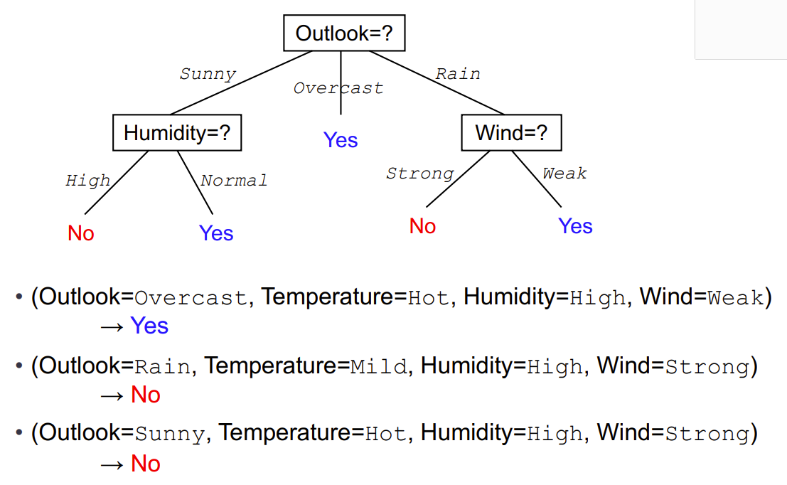
Example of a decision tree

Slide 4
Data to build a decision tree
Outlook | Temperature | Humidity | Wind | Play
Sunny | Hot | High | Weak | No
Sunny | Hot | High | Strong | No
Sunny | Mild | High | Weak | No
Sunny | Cool | Normal | Weak | Yes
Sunny | Mild | Normal | Strong | Yes
Overcast | Hot | High | Weak | Yes
Overcast | Mild | Normal | Strong | Yes
Overcast | Cool | High | Weak | Yes
Rain | Mild | High | Weak | Yes
Rain | Cool | Normal | Weak | Yes
Rain | Mild | High | Strong | No
Rain | Cool | Normal | Strong | No

Slide 5
How to construct it ?
Start with all training data
Find the best split among the features
Divide the data into smaller groups
Repeat the process recursively
Stop when the node is pure or too small
Assign a prediction to each leaf
How to know which is best?
- Entropy

Slide 6
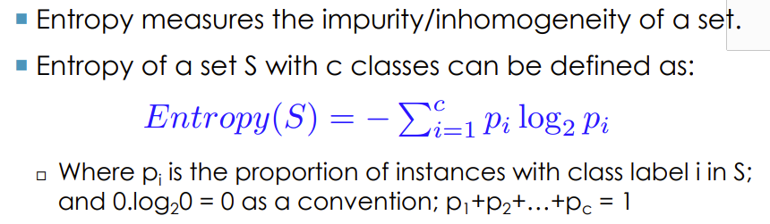

Entropy of decision tree
It does discriminate
It doesn’t discriminate: bad choice

Slide 7
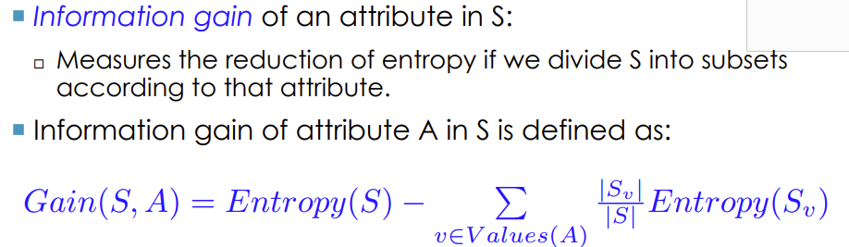
Information gain
The greater is the gain the better is the cut
Disorder before this node
Disorder after this node

Slide 8

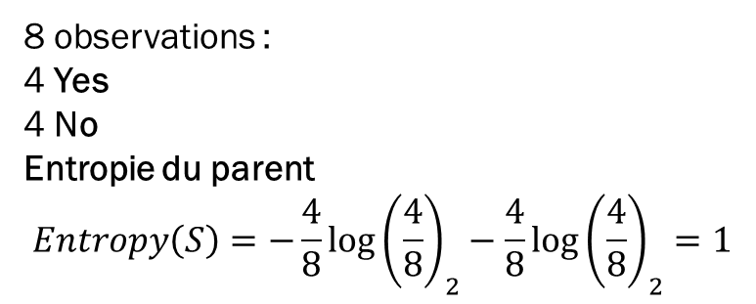



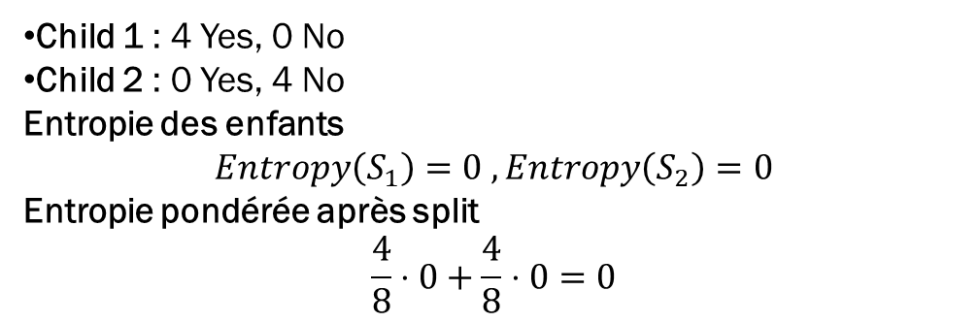


Example
At parent node
After split
8 observations :
4 Yes
4 No
Entropie du parent
$$Entropy\left(S\right)=−\frac{4}{8}{\log\left(\frac{4}{8}\right)}_{2}−\frac{4}{8}{\log\left(\frac{4}{8}\right)}_{2}=1$$
Child 1 : 4 Yes, 0 No
Child 2 : 0 Yes, 4 No
Entropie des enfants
$$Entropy\left(S_{1}\right)=0 , Entropy\left(S_{2}\right)=0$$
Entropie pondérée après split
$$\frac{4}{8}⋅0+\frac{4}{8}⋅0=0$$
Information gain: $Gain=1−0=1$

Slide 9





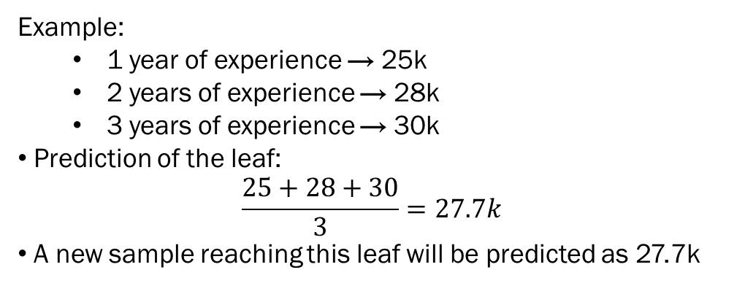
Decision tree for regression
Everything is the same but we predict a value
Example:
1 year of experience → 25k
2 years of experience → 28k
3 years of experience → 30k
Prediction of the leaf:
$$\frac{25+28+30}{3}=27.7k$$
A new sample reaching this leaf will be predicted as 27.7k

Slide 10
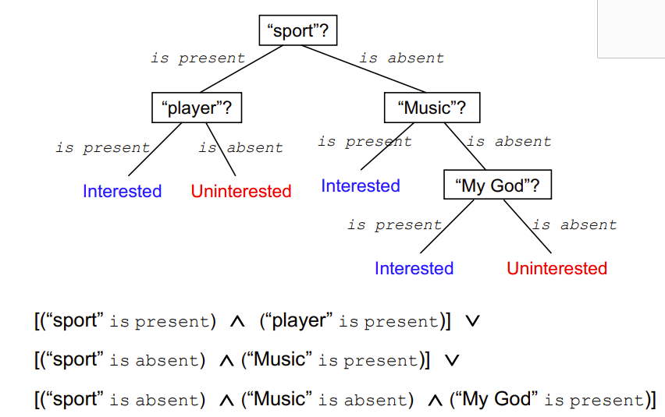
A decision tree seen with disjunction

Slide 11
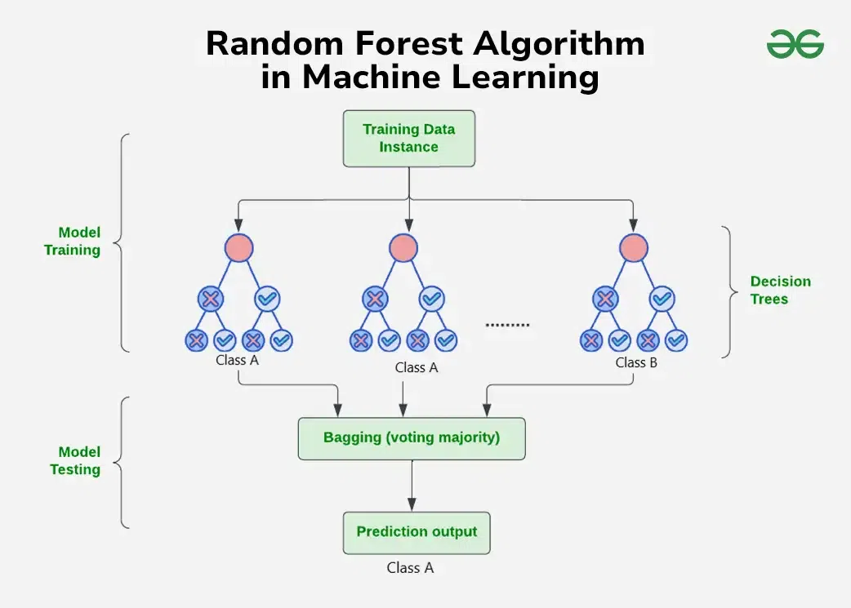
Random forest
Multiple decision trees but why ?
One unique decision tree is unstable
Small changes on data can change a lot
High variance and overfitting
Random forest combines trees for better robustess

Slide 12
Random forest
Train many decision trees on different random samples
Use a random subset of features at each split and still use the best one of this subset
Combine all predictions at the end: we keep the result of the majority (or the average for regression)
Final result = more accurate and more stable

